Slide 1

Selected Topics in Computational Intelligence I
Session 2
Genetic Algorithm

Slide 2
Agenda
Introduction
Population and Chromosome
Mutation, Crossover, Selection
A Simple Example TSP

Slide 3
Introduction
First proposed by Fraser in 1957
Popularized by Holland in 1975
Genetic algorithms (GA) focus on genetic evolution
Main driving operators:
Selection, to model survival of the fittest
Recombination, to model reproduction
Mutation, to introduce new genetic material

Slide 4
Introduction
Computerized search and optimization algorithms based on Darwin’s Principle of Natural Selection
Part of Evolutionary Algorithms
Basic concept - to simulate processes in natural system necessary for evolution
Structural Engineering Problems, Biology, Computer Science, Image processing and Pattern Recognition, physical science, social sciences and Neural Networks
Provide efficient, effective techniques for optimization

Slide 5
Introduction
GA converts design space into genetic space Works with a coding variables
Traditional optimization techniques are deterministic in nature, but GA uses randomized operators
Three important aspects:
1. Definition of objective function
2. Definition and implementation of genetic representation
3. Definition and implementation of genetic operators

Slide 6
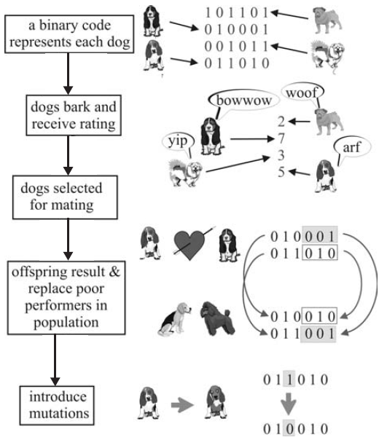
Analogy
shows the analogy between biological evolution and a binary GA.

Slide 7
Population
A number of possible solutions is known as population.
The population in GA also consists of a number of individuals who called chromosome. Chromosome is a representation of problem solving (symbol).
Initial population in genetic algorithm formed randomly, while the next population is formed by the genetic algorithm operators for several generations. In each generation, the chromosomes -chromosome will undergo a process of evaluation by using a measuring instrument called the fitness function (fitness).

Slide 8
Chromosomes
Chromosomes are formed from the previous generation of chromosomes is called as children (offspring). Likewise, the previous generation of chromosomes pairs referred to as the parent (parents)
Crossover allows children who inherit both parents. In the GA reproduction process known as crossing operators (crossover).
In GA, known operators that can alter genes in a chromosome, the operator is referred to as the mutation operator (mutation).

Slide 9
Mutation
To introduce new genetic material into an existing individual
Adds diversity to the genetic characteristics of the population
Applied at a mutation probability, Pm
Given that each gene is mutated at probability pm, the probability that an individual will be mutated is given by

Slide 10
Crossover
To produce offspring by recombining genetic material from parents
Main categories of operators:
asexual – an offspring is generated from one parent
sexual – two parents are used to produce one or two offspring
multi-recombination – more than two parents are use to produce one or more offspring
Selection of parents:
Use any selection operator
Crossover occurs at a crossover probability, p_{c}

Slide 11
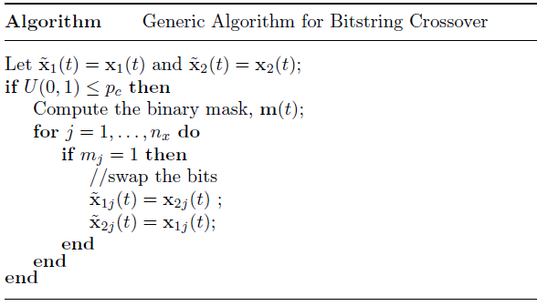
Generic Algorithm for Bistring Crossover
Most of the crossover operators for binary representations are sexual, being applied to two selected parents. If x₁(t) and x₂(t) denote the two selected parents, then the recombination process is summarized in Algorithm below

Slide 12
Selecting Parents
Many schemes are possible so long as better scoring chromosomes more likely selected
Score is often termed the fitness
“Roulette Wheel” selection can be used:
Add up the fitness's of all chromosomes
Generate a random number R in that range
Select the first chromosome in the population that - when all previous fitness’s are added - gives you at least the value R

Slide 13
Example population
No. | Chromosome | Fitness
1 | 1010011010 | 1
2 | 1111100001 | 2
3 | 1011001100 | 3
4 | 1010000000 | 1
5 | 0000010000 | 3
6 | 1001011111 | 5
7 | 0101010101 | 1
8 | 1011100111 | 2

Slide 14
Roulette Wheel Selection
1
2
3
4
5
6
7
8
1
2
3
1
3
5
1
2
0
Rnd[0..18] = 7
Chromosome4
Parent1
Rnd[0..18] = 12
Chromosome6
Parent2
18

Slide 15
Crossover - Recombination
1010000000
Parent1
Offspring1
1011011111
1001011111
Parent2
Offspring2
1010000000
Crossover single point - random
With some high probability (crossover rate) apply crossover to the parents. (typical values are 0.8 to 0.95)

Slide 16
Mutation
mutate
Offspring1
1011011111
Offspring1
1011001111
Offspring2
1010000000
Offspring2
1000000000
Original offspring
Mutated offspring
With some small probability (the mutation rate) flip each bit in the offspring (typical values between 0.1 and 0.001)

Slide 17
Types of Operators
Reproduction: process of producing offspring from selected parents by applying crossover and/or mutation operators
Crossover: is the process of creating one or more new
individuals through the combination of genetic material randomly selected from two or more parents
Mutation:
The process of randomly changing the values of genes in a chromosome
The main objective is to introduce new genetic material into
the population, thereby increasing genetic diversity

Slide 18
A Simple Example TSP
The Traveling Salesman Problem:
Find a tour of a given set of cities so that
each city is visited only once
the total distance traveled is minimized

Slide 19
Representation
Representation is an ordered list of city
numbers known as an order-based GA.
1) London 3) Dunedin 5) Beijing 7) Tokyo
2) Venice 4) Singapore 6) Phoenix 8) Victoria
CityList1 (3 5 7 2 1 6 4 8)
CityList2 (2 5 7 6 8 1 3 4)

Slide 20
Crossover
Crossover combines inversion and
recombination:
* *
Parent1 (3 5 7 2 1 6 4 8)
Parent2 (2 5 7 6 8 1 3 4)
Child (5 8 7 2 1 6 3 4)
This operator is called the Order1 crossover.

Slide 21
Mutation
Mutation involves reordering of the list:
* *
Before: (5 8 7 2 1 6 3 4)
After: (5 8 6 2 1 7 3 4)

Slide 22
TSP Example: 30 Cities

Slide 23
Solution _{i} (Distance = 941)

Slide 24
Solution _{j}(Distance = 800)

Slide 25
Solution _{k}(Distance = 652)

Slide 26
Best Solution (Distance = 420)

Slide 27
Overview of Performance

Slide 28
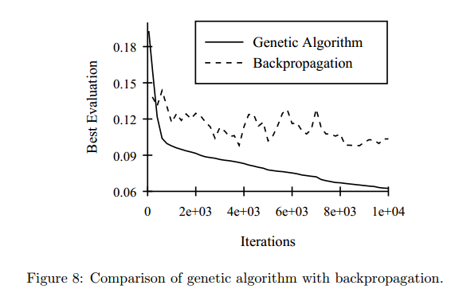
GA VS Backpropagation

Slide 29
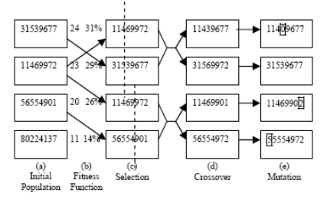
Implementation
GA for finding optimum value from a function
GA for class scheduling problem
GA for optimization of Radio Base Station
GA for Data Time Series prediction
GA for robotics and Neural Network

Slide 30
Exercise
School timetable scheduling problem presents a set of tasks (classes) and a set of resources (rooms and instructors). No conflicting classes (which allocate the same resource, a student group or an instructor) are placed in the same timeslot.Create a demo program for Scheduling using GA.
The timetable scheduling process could be formally defined with binary variables x_{cdtrgi}, which have the value of 1 if and only if instructor i lectures the class c on day d at time t, for group g in room r.
example Input:
1. Tabel Mata Kuliah
AI, Algo, PTI, Web
2. Tabel Dosen
Lili, Widodo, Bayu, Novita,
Meiliana
3. Tabel day
A1, A2,A3
4. Tabel Ruang
R1, R2, R3, R4

Slide 31
References
Andries P. Engelbrect. (2007), Computational Intelligence An Introduction. 2nd Ed. John Wiley & Sons. USA. ISBN: 978-0-470-03561-0
James M. Keller, Derong Liu, David B. Fogel (2016). Fundamentals of Computational Intelligence. Neural Networks, Fuzzy Systems and Evolutionary Computation, Wiley ISBN 978-1-110-21434-2
Bansal, Jagdish Chand, Pramod Kumar Singh, and Nikhil R. Pal . (2017) "Evolutionary and Swarm Intelligence Algorithms", Springer, ISBN 978-3-319-91339-1
Bernhard, Korte, and J. Vygen (2008), "Combinatorial optimization: Theory and algorithms." Springer, Third Edition.

Slide 32
Thank You

